Slide 1
BCD-Binary Converter
GROUP E
Ahiezer Lopez
Joe Si
Sander Zuckerman

Slide 2
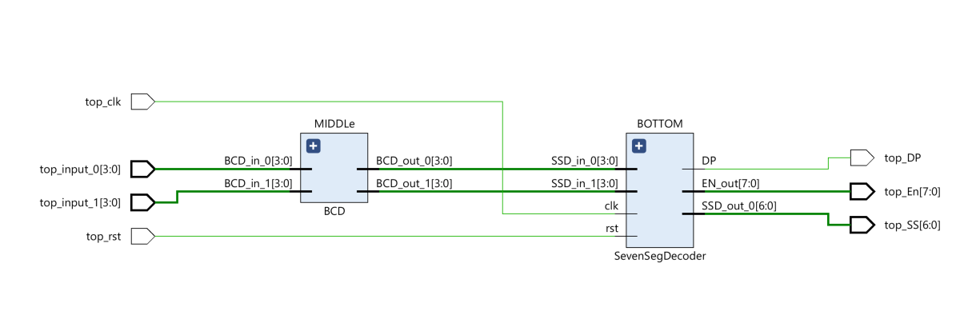
Contributions:
BCD-SS Implementation
Joe Si
SS and Top Module
Ahiezer Lopez
BCD Converter
Sander Zuckerman

